Slide 1
Smart Control Action Classification with XGBoost

Slide 2
Why XGBoost?
Gained immense popularity at Kaggle competitions
Highly sophisticated with low training times
Performs exceptionally well with tabular datasets
Efficient handling of missing data

Slide 3
Our Dataset
(Oi diagram ta add koris je ThingSpeak theke amra CSV te nitesi namaiya)

Slide 4
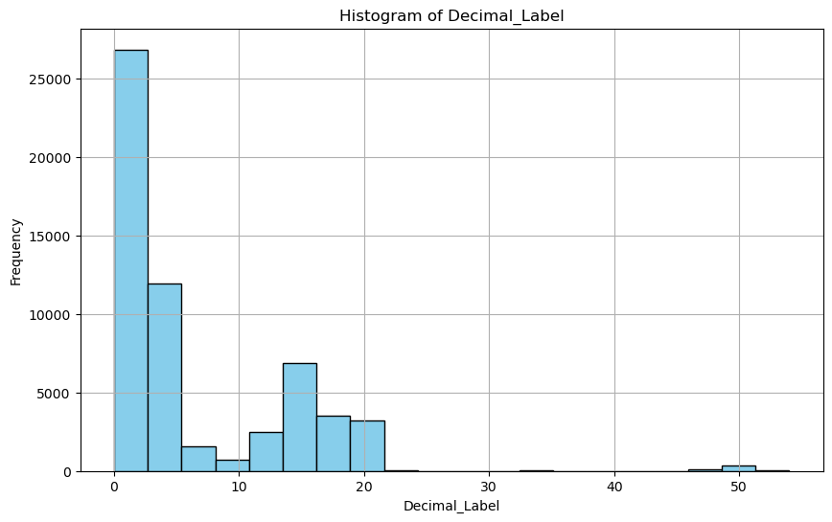
Our Dataset
Number of data points = 57,638
Number of Classes = 20
Dataset is imbalanced due to controlled environment
Fig. : Distribution of Class Instances in the dataset

Slide 5
Building the XGBoost Classifier
Training, Validation and Test set split = 60% : 20% : 20%
Training time = 27.440 seconds
Optimal Hyperparameter Values:

